Slide 1

S/4HANA Machine Learning Workshop Bangalore, Shanghai, Walldorf Q3/2018
S/4HANA Architecture and Enablement, Palo Alto

Slide 2
Misc. Topics
Training Environment
Notebooks
Python and/or R
Model Servers
Software 2.0 / Differentiable Programming

Slide 3
Our Training Environment
There are several (excellent) ML trainings available to SAP employees that show how to invoke a particular ML algorithm in Predictive Analysis (expert and automated mode), PAL, R, Python, and Excel.
We will focus instead on Python, Scikit-Learn, and TensorFlow.
Python has recently bypassed R as the most popular programming language for machine learning.
Scikit-Learn is a well-designed, very easy to use and extremely popular library for ML.
TensorFlow is a more low-level library for developing and serving machine learning algorithms (though more and more high-level components have been added (Keras, scikit-learn inspired predictors, etc.) TensorFlow is very fast and scalable. Moreover, it provides a lot of features that make the design and evaluation of machine learning models much easier.
Please note that PyTorch is gaining a lot of traction as well. We will provide a brief comparison between the two libraries.

Slide 4
Why Python, Scikit-Learn, and TensorFlow?
By focusing on Python, Scikit-Learn, and TensorFlow, we
Utilize the same tools that are used in academia and industry (and benefit directly from open-source contributions)
Remain flexible
Are completely aligned with Leonardo ML, which is critical for the productive use of ML models from within our applications (more on this later)
Finally, our goal is not so much to cover as many algorithms as possible, but to get a deeper understanding of how some of the most popular algorithms work and – more importantly – how they are related to each other. In other words, by the end of the week, you should have a solid understanding of the most important ML concepts.
Please note: If PAI and PAL meet your requirements (this is typically the case if your datasets are small and/or reside in HANA), please use them! In fact, this training should make it easier to utilize our own tools by first experimenting with various algorithms, feature transformations and hyperparameters using Jupyter notebooks.

Slide 5
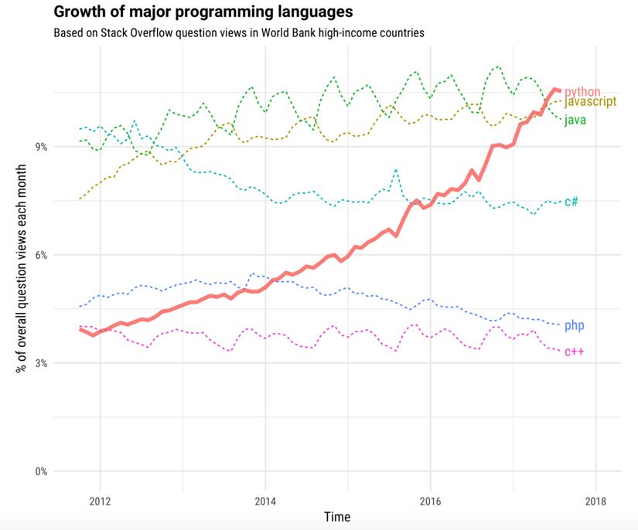
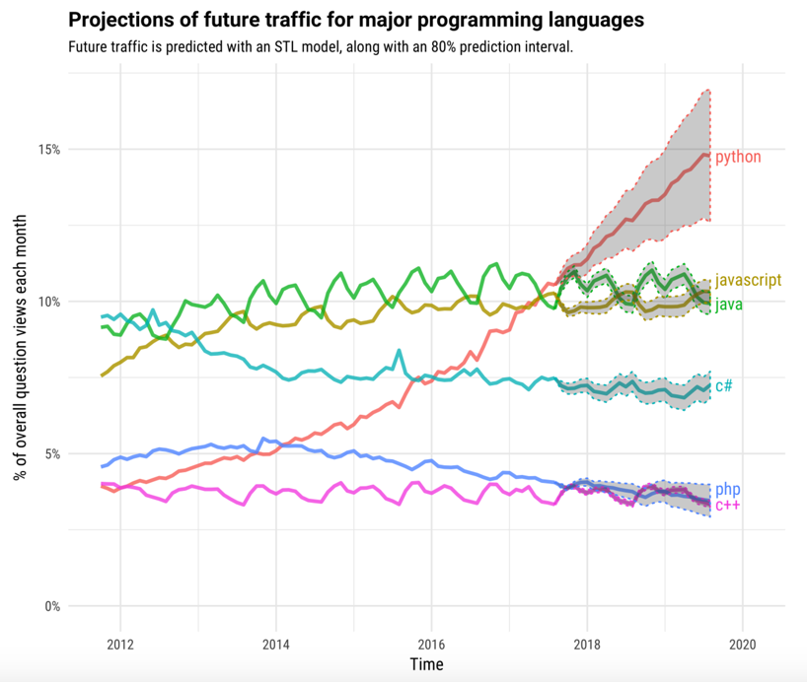
The Incredible Growth of Python
https://stackoverflow.blog/2017/09/06/incredible-growth-python/

Slide 6
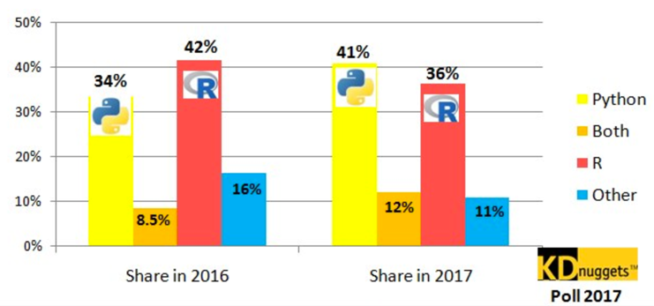
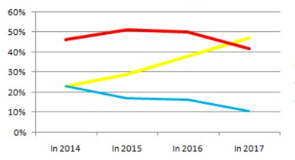
Python, R for Analytics, Data Science and Machine Learning
http://www.kdnuggets.com/2017/08/python-overtakes-r-leader-analytics-data-science.html

Slide 7
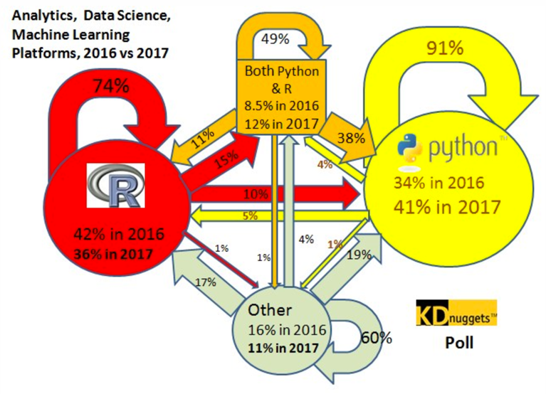
Python, R for Analytics, Data Science and Machine Learning
http://www.kdnuggets.com/2017/08/python-overtakes-r-leader-analytics-data-science.html

Slide 8
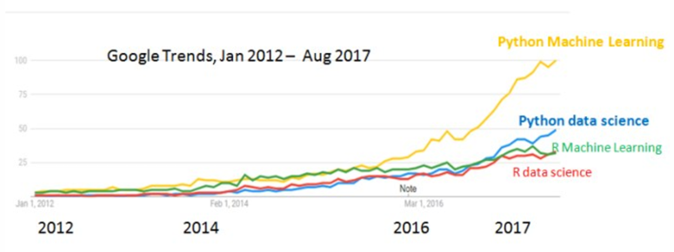
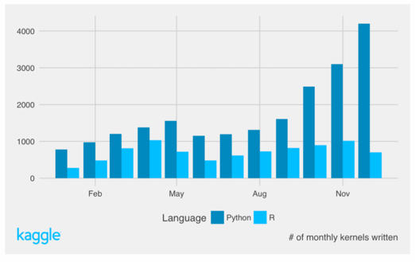
Python, R for Machine Learning vs. Data Science
http://www.kdnuggets.com/2017/09/python-vs-r-data-science-machine-learning.html

Slide 9
Why Scitkit Learn?
Scikit-Learn is extremely well designed, and even inspired the design of other machine learning tools, such as Apache Spark’s pipelines (see next slide) or the high-level estimators in TensorFlow).
All algorithms in Scikit-Learn have a consistent interface
All hyper parameters as well as the learned parameters of the estimators are accessible
The building blocks (transformers, estimators, and predictors) are composable into machine learning pipelines
The estimators have sensible defaults (and work out-of-the-box)
The datasets are all based on NumPy arrays or SciPy’s sparse matrices

Slide 10
Scitkit-Learn: Estimators
Supervised Learning
model.fit(X, y) # Fit training data; X = data, y = labels
model.predict(X_new) # Returns predicted labels
model.predict_proba(X_new) # Only available for some classifiers: Returns probability of each label
model.score() # Number between 0 and 1; larger number => better fit
Unsupervised Learning
model.fit(X) # Fit training data
model.transform(X_new) # Transform new data
model.fit_transform(X) # Efficiently perform a fit and transform of input data, not available for all estimators
Most useful features: Preprocessing (e.g. StandardScaler, OneHotEncoder), grid search, cross-validation, pipelines

Slide 11
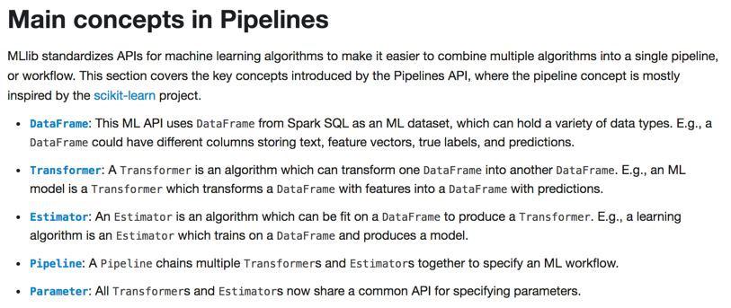

Spark Pipelines (inspired by scikit-learn)

Slide 12
When not to use Scikit-Learn?
Scikit-learn is easy to use and has sophisticated algorithms that work with medium-sized data.
Sometimes the data doesn’t fit into memory. Though some of Scikit-Learn’s algorithms support out-of-core processing by providing a partial_fit method that receives batches of training data, you might want to consider distributed environments such as Spark ML and/or TensorFlow.
You obviously can’t use if the algorithm you want to use is not available. For instance, you just read about a new algorithm on https://arxiv.org/ and want to implement it yourself.
You should use TensorFlow (with or without Keras) or PyTorch for deep learning (CNN, LSTMs, VAEs, GANs, …) or RISELab’s Ray for RL.
Finally, once you have settled down on your algorithm, transformed your data, determined all hyperparameters, etc., you might want to check whether our own tools (e.g. PAL) may provide a similar functionality.

Slide 13
TensorFlow
TensorFlow has been developed by Google and was open sourced in 2015. The main focus is the design, building, training and serving of deep neural networks, though it can be used for the development of pretty much any machine learning algorithm.
The main concept behind TF is a dataflow graph, where nodes represent operations, and data (in form of multi-dimensional arrays – so-called tensors) flows through the edges. There is a clear separation between the creation of the graph and the (efficient) execution of the graph.
(The concept is very similar to calculation scenarios in HANA, or even the so-called logical plans in Apache Spark. )
TensorFlow supports the efficient processing of data flow graphs in a distributed environment, a great tool for monitoring (TensorBoard). It also calculates the gradients for backpropagation automatically, which makes the development of deep neural networks much easier.

Slide 14
Quiz: What do the following slides have in common?

Slide 15
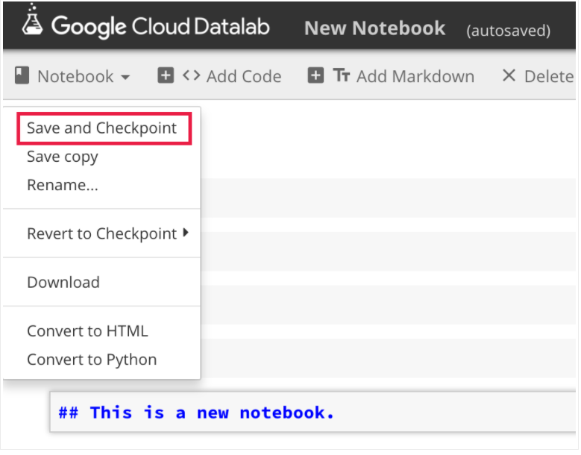
Google Cloud Datalab

Slide 16
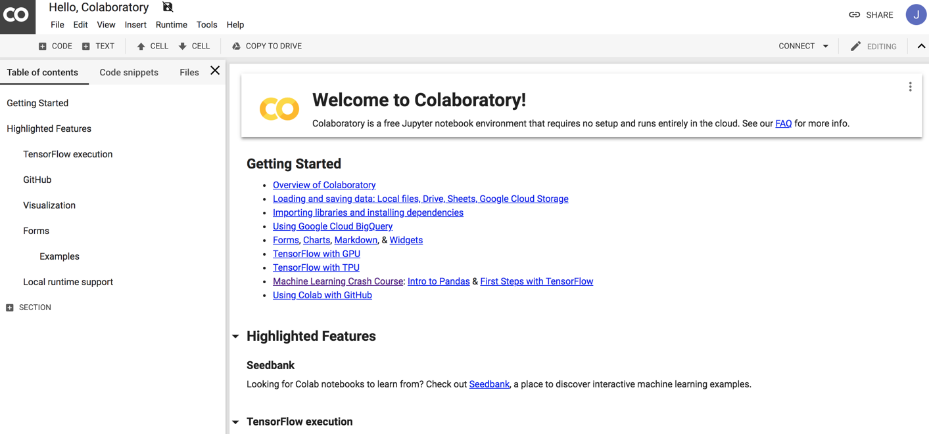
Google Colaboratory (a.k.a. Colab)

Slide 17
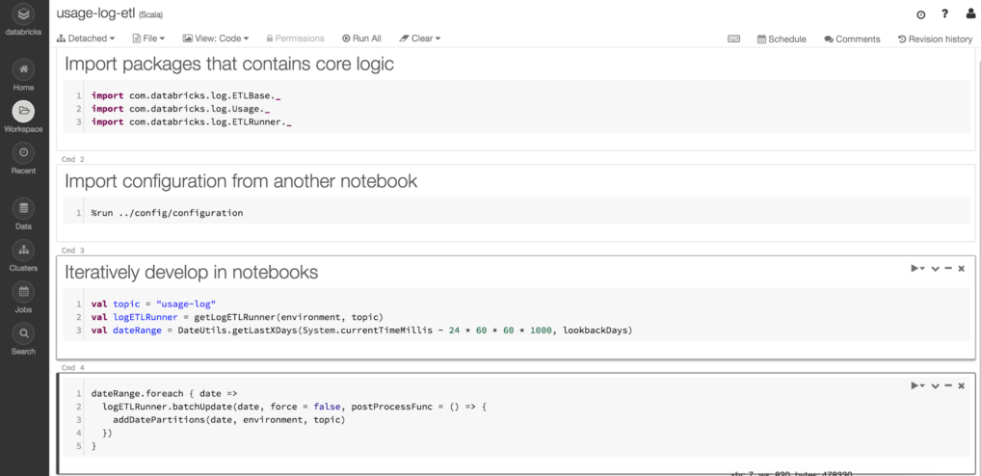
Databricks

Slide 18
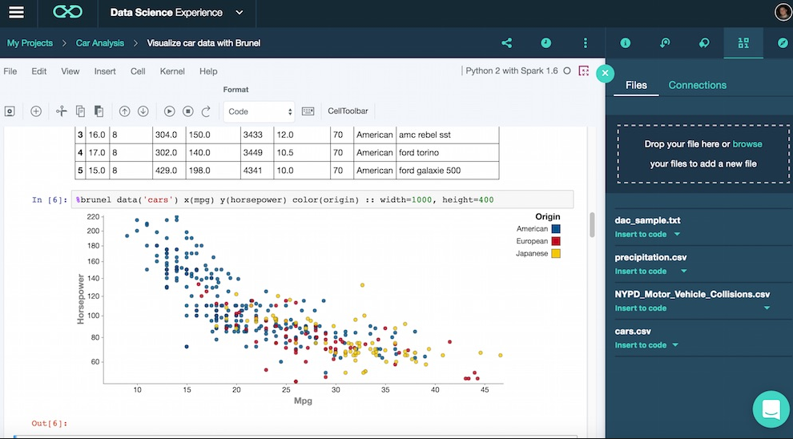
IBM Watson Data Platform

Slide 19
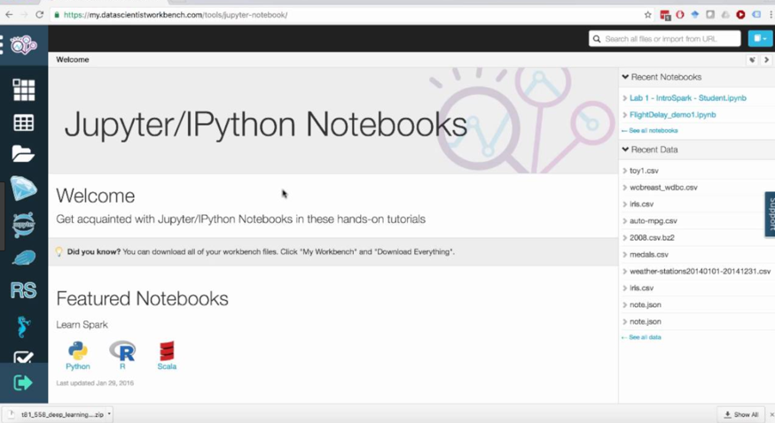
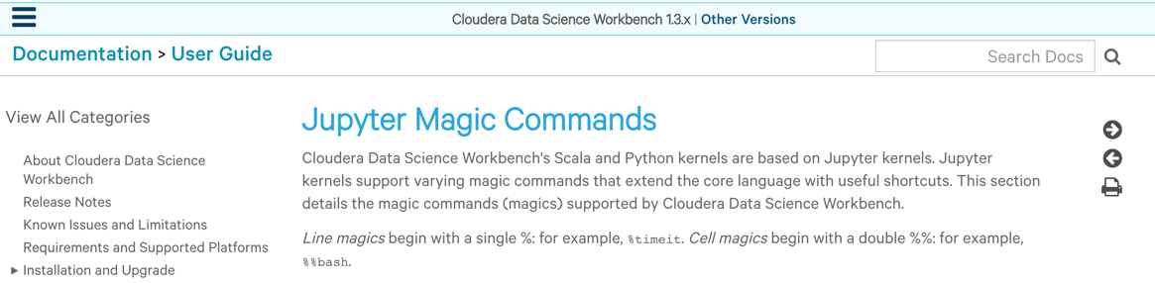
Cloudera Data Science Workbench

Slide 20
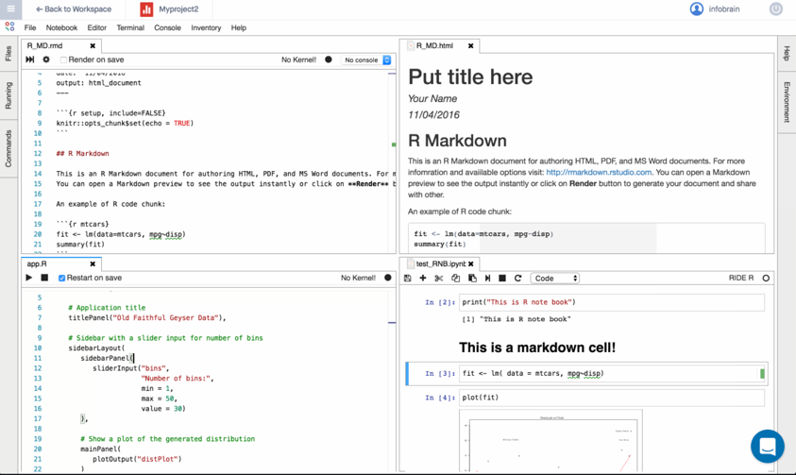
R-Brain (based on JupyterLab)

Slide 21
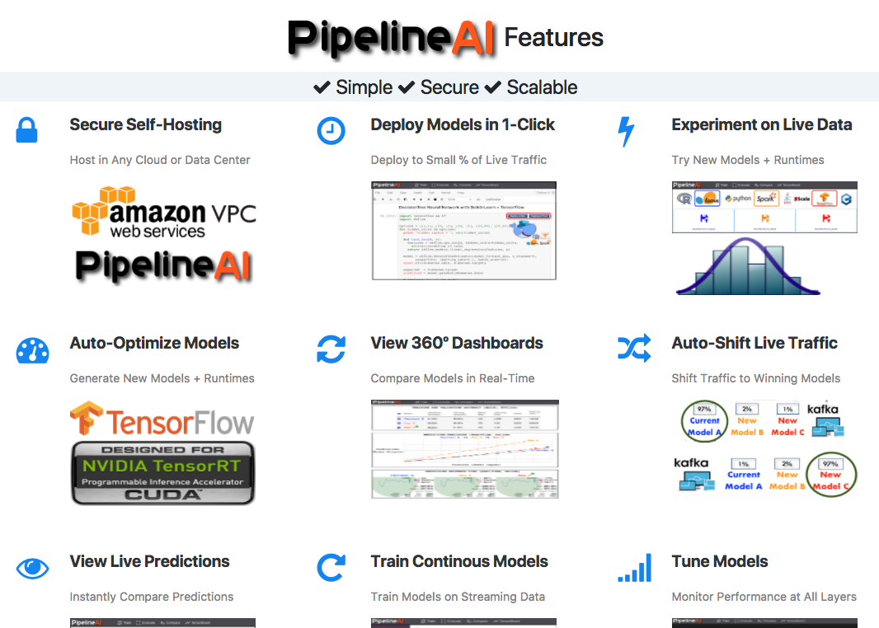
Pipeline AI

Slide 22
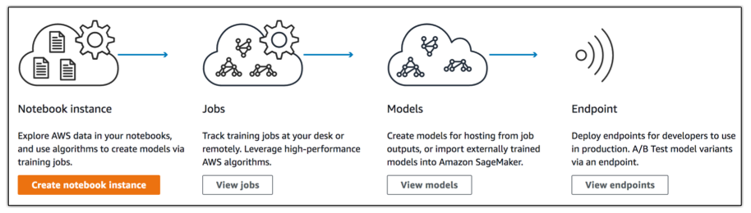
Amazon SageMaker

Slide 23
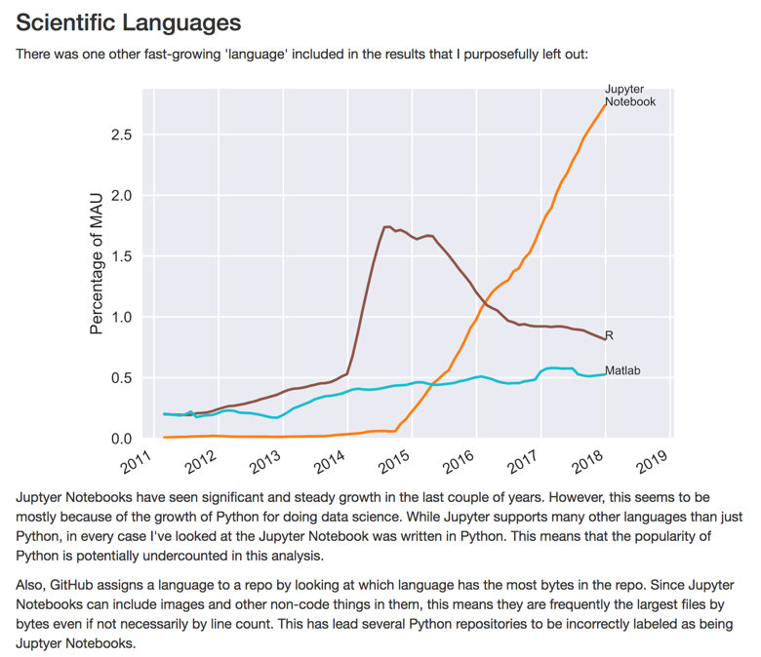
Monthly Active Users (MAU) on GitHub
http://www.benfrederickson.com/ranking-programming-languages-by-github-users/

Slide 24
How many (actual) Jupyter Notebooks are on GitHub?

Slide 25
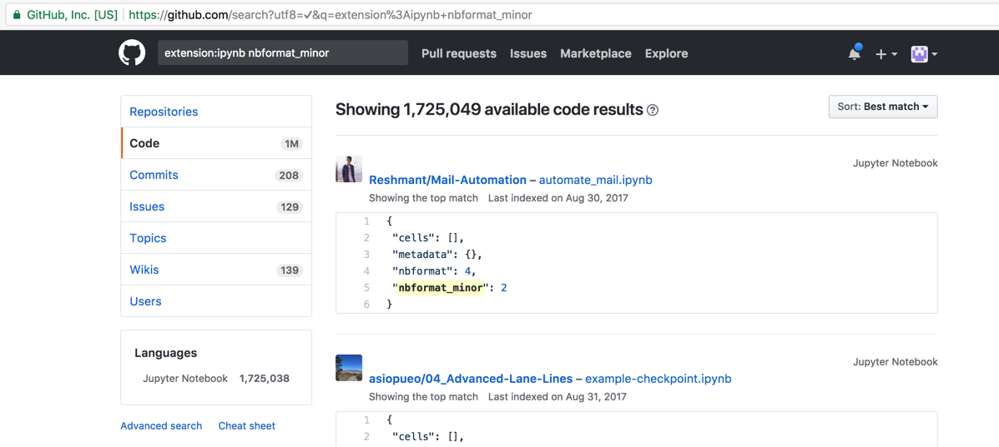
How many (actual) Jupyter Notebooks are on GitHub?
Try it out: https://github.com/search?q=extension%3Aipynb+nbformat_minor

Slide 26
Demo: JupyterHub

Slide 27
“Side-by-Side vs. Embedded”
Not on Day 1

Slide 28
Embedded R – Really???
CREATE PROCEDURE USE_SVM( IN train "spamTraining", IN eval "spamEval", OUT result "spamClassified")
LANGUAGE RLANG AS
BEGIN
library(kernlab)
model <- ksvm(type~. , data=train, kernel=rbfdot(sigma=0.1))
classified <- predict(model, eval [,-(which(names(eval) %in% "type"))])
result <- as.data.frame(cbind(eval, classified))
END;
# This example is from the “R Integration Guide”
# How do I test this function? Should I really use a radial basis function?
# What parameters should I choose for sigma (and c)? I really would like to visualize the decision boundary.
# Besides, do you really want to use a single function for training and prediction? (This is embarrassing.)

Slide 29
Embedded R – How about … ?
[In R Notebook or RStudio]
train <- HANAread(hdb, ”spamTraining”)
eval <- HANAread(hdb, “spamEval”)
library(kernlab)
USE_SVM <- function(train) {
model <- ksvm(type~. , data=train, kernel=rbfdot(sigma=0.1))
classified <- predict(model, eval [,-(which(names(eval) %in% "type"))])
return as.data.frame(cbind(eval, classified))
}
# Then test (is a radial basis function the best kernel? Try different values for sigma (and c)…. and finally deploy – all in R notebook or Rstudio
library(HANAmodelDeployer)
modelDeploy(conn, ”RContainer”, “USE_SVM”, replicas=2)
In SQL Script: CALL RContainer(“USE_SVM”, :newtrain, :subset2, result); # Complete code in the R Integration Guide

Slide 30
Embedded Scenarios
Proposal:
Develop ML models (or arbitrary Python/R functions) in a notebook-based environment (side-by-side
and with optimal HANA integration) and provide a tool to (optionally) embed those models in HANA
-- or deploy to the Leonardo ML platform and access the models from HANA via EML
Benefits:
Consistent solution for both Python and R supporting both embedded and side-by-side scenarios
Stable, scalable and fault-tolerant

Slide 31
Demo: Model Deployment

Slide 32
Side-by-Side Scenario
Allow data scientists to work in their preferred environments (Jupyter/R Studio) rather than (the current version of) HANA Studio or Web IDE
Other requirements:
High-performance (e.g. 0MQ)
Parallel data transfer if external environment is distributed (e.g. Spark)
Support for joins with operator push-down (if applicable) – See Nanda’s presentation!
Access to HANA views (S/4HANA requirement: ABAP CDS Views in HANA – this is a longer discussion…)
The proposed solution should be based on JupyterLab which is integrated into the HANA Web IDE. Even though JupyterLab is open source, it can be highly customized and combined with proprietary extensions. (Though the Jupyter notebook format needs to be supported in order to utilize the 1.7 million notebooks on GitHub.)
Pretty much every ML platform vendor has chosen this approach (and managed to incorporate their own features.)

Slide 33
Other Considerations for Side-by-Side Scenarios
Apache Arrow
Support for PySpark, R, Python (Pandas), C++, JS and Parquet
Zero Copy
Embed Spark Data Source API as a small client library (no Spark Cluster needed)
Pushdown of joins, filters and aggregates to HANA
Parallel data transfer
Data can be partitioned during transfer to enable efficient hash joins with external datasets

Slide 34
Other comments
There is (currently) no Python (or R) development / training environment for PAL.
A Jupyter extension to select and test PAL algorithms and build ML pipelines would be ideal (and easy to develop).
We tried something similar for both PAL and Python a long time ago:
https://github.wdf.sap.corp/paloalto/XPF
Nanda is currently working on a solution (see his demo)

Slide 35
Appendix
Clipper Model Server
(We are working closely with our colleagues from ICN in Singapore to determine whether some of the Clipper features (in particular the flexible model deployment) can be integrated into the Leonardo ML platform.)

Slide 36
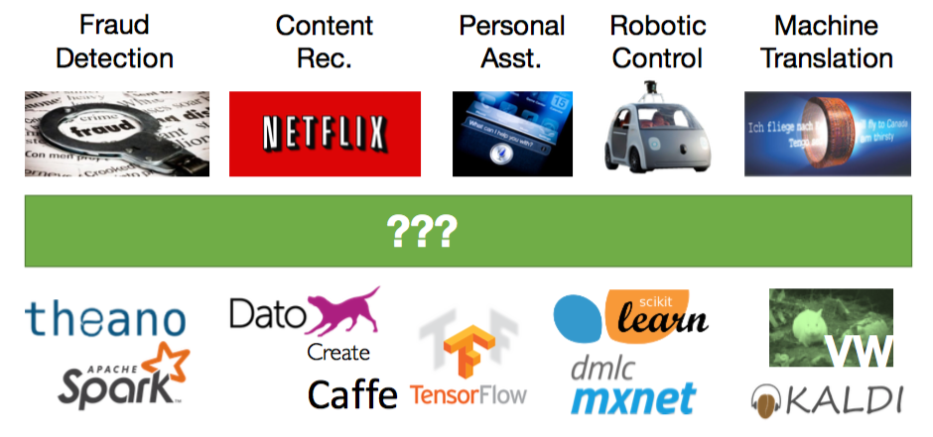
Can we decouple models and applications?
Source: Daniel Crankshaw, Clipper, Spark Summit East, Feb. 2017

Slide 37
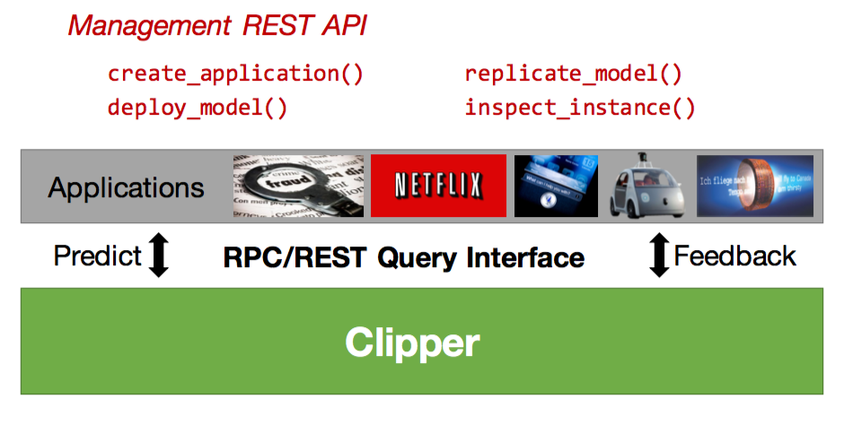
From the Application Developer’s Perspective
Source: Daniel Crankshaw, Clipper, Spark Summit East, Feb. 2017

Slide 38
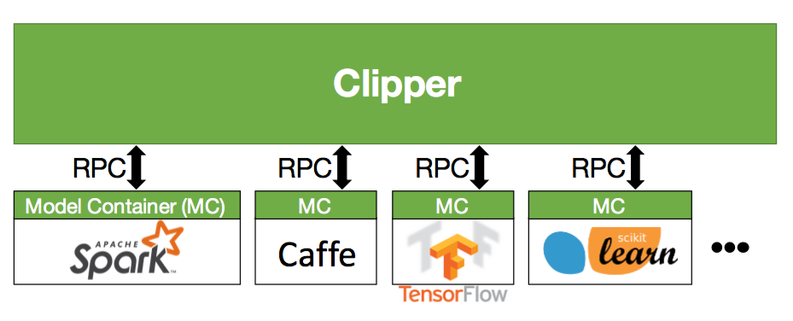
From the Data Scientist’s Perspective
Source: Daniel Crankshaw, Clipper, Spark Summit East, Feb. 2017

Slide 39
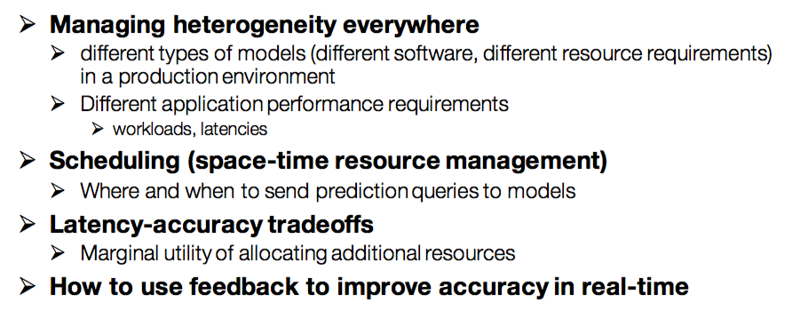
Challenges
Source: Daniel Crankshaw, Clipper, Spark Summit East, Feb. 2017

Slide 40
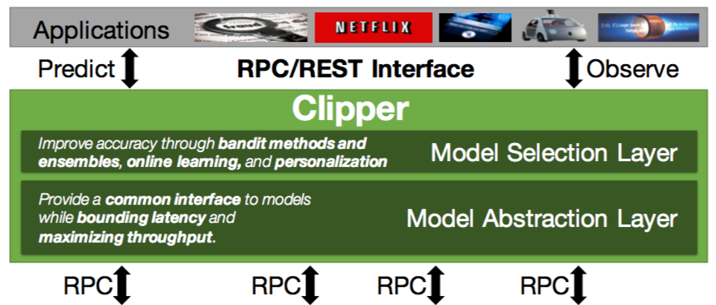
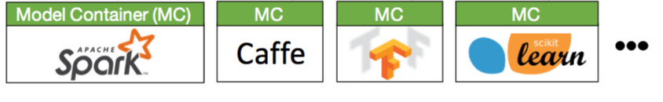
Clipper Architecture
Source: Daniel Crankshaw, Clipper, Spark Summit East, Feb. 2017

Slide 41
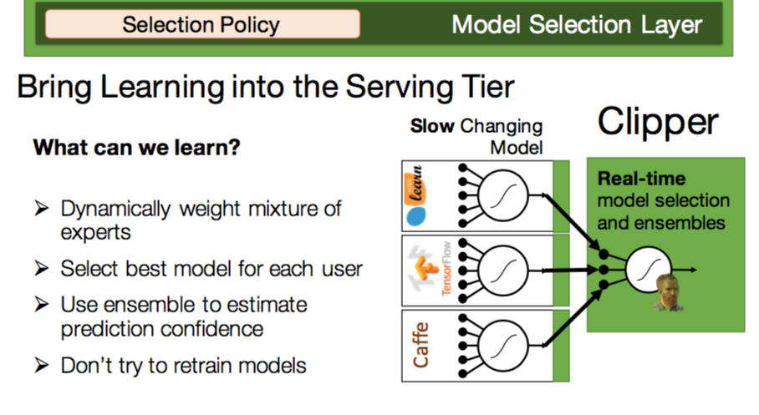
Outlook
Source: Daniel Crankshaw, Clipper, Spark Summit East, Feb. 2017

Slide 42
Model Server POC Demo
ML Application/Model Creation Process
Model training and validation
Model deployment (automated serialization and containerization)
Model assignment to ML application
Model Selection
Dynamic switching of models (based on different ML libraries/platforms) while the application is running
Features: result caching, scalability (via model replicas), response time guarantees, model statistics…

Slide 43
POC Demo: Summary
This is what we have shown:
2 ML applications (Cifar10, Iris)
Models built on four frameworks:
PAI
SciKit-Learn
TensorFlow
Spark ML

Slide 44
Model Server Architecture
ML User/App
SAP Cloud Identity
ML Practitioner Data Scientist
R
REST/gRPC
R
R
Load Balancer
OAuth / XSA UAA
R
Training Environment
R
R
Model
Training Data
R
Query Server
Deploy Model
Serialize
Model Config
Model Admin Service
R
Deployment
Model Selection
SLA / Adaptive Batching
(Redis)
Launch & Control Containers
Logging / Audit
Prediction Cache
Model Repository
(serialized models)
Model Containers
Inf. Request (gRPC)
R
Logs
Kubernetes
R
Monitoring
External
Kubernetes and/or External

Slide 45
Appendix
Jupyter Environment

Slide 46
Kubernetes Cluster for S/4HANA Machine Learning Training
Personal Jupyter Server
HDFS NameNode
Personal Jupyter Server
Personal Jupyter Server
Zookeeper
Kubernetes Pods
JupyterHub
HDFS DataNode
Deployed to specific node (e.g. to achieve data locality)
Spark Worker
Personal Jupyter Server
Spark Worker
HDFS DataNode
Personal Jupyter Server
Deployed to nodes based on available resources
Personal Jupyter Server
Personal Jupyter Server
Jupyter Proxy
HDFS DataNode
Personal Jupyter Server
Personal Jupyter Server
Zookeeper
Spark Worker
TensorFlow Serving
Local Storage HDFS
Local Storage HDFS
Personal Jupyter Server
Local Storage HDFS
Personal Jupyter Server
Personal Jupyter Server
Kafka Broker
Personal Jupyter Server
K8S Node 10.125.0.132 (80 Cores / 1 TB)
K8S Node 10.125.0.133 (80 Cores / 1 TB)
K8S Node 10.125.0.134 (80 Cores / 1 TB)
/Public/Datasets
/Public/Notebooks
/SharedContent
/User1 Share
/User2 Share
…
Personal Jupyter Server
HDFS DataNode
Personal Jupyter Server
Personal Jupyter Server
Kafka Broker
Personal Jupyter Server
Spark Worker
Personal Jupyter Server
Personal Jupyter Server
Spark Master
HDFS DataNode
Spark Worker
HDFS DataNode
TensorFlow Serving
TensorFlow Serving
Personal Jupyter Server
Spark Worker
Personal Jupyter Server
Personal Jupyter Server
Personal Jupyter Server
Local Storage HDFS
Zookeeper
Local Storage HDFS
Local Storage HDFS
Personal Jupyter Server
Personal Jupyter Server
Kafka Broker
K8S Node 10.125.0.135 (80 Cores / 1 TB)
K8S Node 10.125.0.136 (64 Cores / 512 TB)
K8S Node 10.125.0.137 (64 Cores / 512 GB)
NFS Server 10.125.2.77

Slide 47
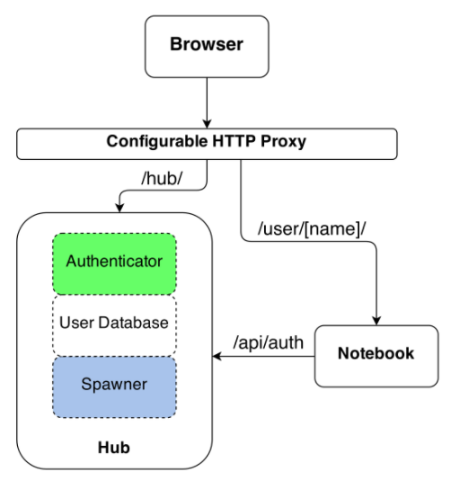
JupyterHub on Kubernetes with SSO
Single-User Notebook Server: a dedicated, single-user, Jupyter Notebook server is started for each user on the system when the user logs in. The object that starts these servers is called a Spawner.
Proxy: the public facing part of JupyterHub that uses a dynamic proxy to route HTTP requests to the Hub and Single User Notebook Servers.
Hub: manages user accounts, authentication, and coordinates Single User Notebook Servers using a Spawner.

Slide 48
Jupyter Notebook Kernels
Spark 2.4 (Scala, based on Apache Toree)
PySpark (Apache Toree)
SparkR (Apache Toree)
SQL (Apache Toree)
Python 3
Python 2 (needed for DeepMind Sonnet TensorFlow library)
R
Spark Magic (for Livy Spark Rest Service)
The Python kernels (PySpark, Python 2 and 3) are fully loaded:
SciKit-Learn
TensorFlow
Pandas, …

Slide 49
Deployments (in Addition to JupyterHub)
Apache Spark (scalable cluster based on StatefulSets)
Hadoop File System (HDFS)
Apache Kafka 0.10 [+ Confluent’s Schema Registry]
TensorFlow Serving [+ Inception Server (Image Recognition)]
Vora (based on helm charts developed by Dmitri Kiselev and Eugene Kossyak)
SQL Engine
vFlow
…

Slide 50



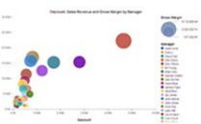

Democratize Data Access for SAP HANA, Vora and Apache Spark
Mashup Enhancements
Open Programming
Modeler
Notebook
Lumira
Apache Toree (Spark Kernel) / dVDM Persistency / JDBC / open CDS
oData
In-Memory Store
Application Services
Extended Spark – HANA Data Source API
Processing Services
Database Services
Integration Services
HDFS
SAP HANA Platform
Interactively combine HANA VDMs with data stored in Vora and HDFS in Jupyter or use the Vora Modeler to build multi-dimensional data models
Benefit from the automatic push-down of calculations to HANA and Vora. Utilize Spark Streaming, the machine learning and graph analytics library
Consume the distributed Virtual Data Models in S/4HANA via oDATA, or Lumira and other BI clients via JDBC

Slide 51
Questions?

